Slide 1
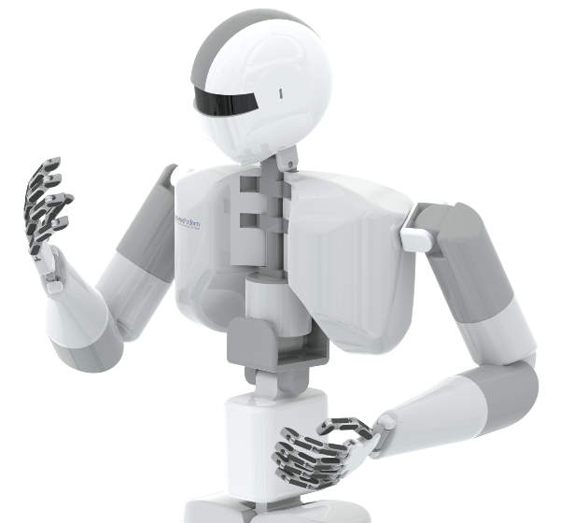
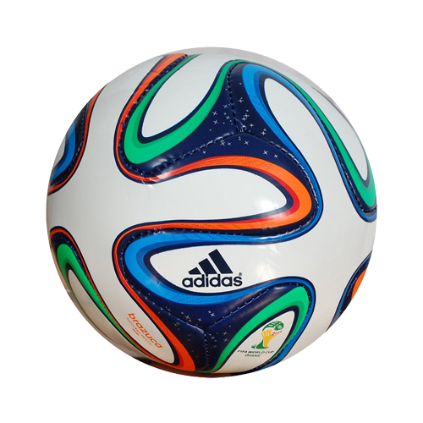
Qualitative Case-Based Reasoning for Humanoid Robot Soccer
A New Retrieval and Reuse Algorithm
Team FT05

Slide 2
Outline
Introduction to CBR and Quality Spatial Representation (QSR)
Qualitative Representation of Problem Statement
Case Retrieval and Reuse Methodologies
Experimental Results
Summary

Slide 3
Introduction
Limitations of Metric Coordinates in Humanoid Applications.
Solving for these Limitations:
Qualitative spatial reasoning theory to model
Use of EOPRA and Retrieving or reusing cases based on spatial relations.
A new Retrieval algorithm is proposed that uses the Conceptual Neighborhood Diagram to compute the similarity measure.
A Reuse algorithm is also introduced that selects the most similar case and shares it with other agents.
With Qualtitative CBR, the robots averaged a higher number of goals than those obtained when running a metric CBR approach.
Notes:
* EOPRA: a QSR approach that aims the representation of orientation and distance between objects with respect to the intrinsic direction of the agents.
* Instead of representing cases in cartesian Coordinate system, we use : 8 qualitative orientation regions and 6 qualitative distance regions.
* The proposed algorithms use the concept of Conceptual Neighborhood Diagram (CND) and a cost function to compute the similarity measure between the problem and the case base.
* From the spatial distance and direction obtained by the sensor, qualitative spatial regions can be created, allowing reasoning about, and comparison of, relations between domain objects, the regions they are located and their regions of occupancy.
Humanoid projects using metric coordinates produces a very high error rate as it uses a camera for input mapping.

Slide 4

What is Humanoid Soccer?
The experiment involves a team of humanoid robots playing a soccer game against an opponent team.
Two types of experiments were performed:
The ﬁrst was conducted in simulation software, in which the proposed approach was compared to the quantitative approach described in [1] and to a reactive approach.
Second, experiments were executed with real robots where the present work was compared with a reactive approach.
In both experiments, the number of goals scored and the retrieval time were analyzed.
[1]-Ros, R., Arcos, J.L., de Mantaras, R.L., Veloso, M.: A case-based approach for coordinated action selection in robot soccer. Artif. Intell. 173(9–10), 1014–1039 (2009)
Notes:
[1]- Uses the CBR approach for coordinated action selection in robot soccer domain, using the Cartesian coordinate system to represent the position of objects in the ﬁeld.
[1]-Proposed a retrieval method in which the similarity is evaluated along three important aspects:
The similarity between the problem and the case,
The cost of adapting the problem to the case and
The applicability of the solution of the case.
The present work diﬀers from [1] since it discretizes the world into spatial representation and proposes a faster retrieval algorithm that can be used in robots with limited processing power

Slide 5
Earlier Implementations
One of the ﬁrst architectures that includes a deliberative CBR system for soccer playing agents
High-level planning strategies, which included a CBR system.
CBR in a RoboCup soccer-playing agent playing in the Simulation League, where the agent “builds a case base by observing the behavior of existing players and determining the spatial conﬁguration of the objects the existing players pay attention to.
Architecture to control more complex soccer behaviors such as dribbling and goal scoring applied to humanoid multi-robot scenarios.
2002
2003
2008
2015
2017
Presented 3 CBR prototypes developed for a team in the RoboCup small size league, in which CBR was used to position the goalie, select team formations and recognize game states for the team.
Representation based on fuzzy histograms of objects and similarity metric based on the Jaccard Coeﬃcient to compare the histograms
Notes:
[2]. Lin, Y., Liu, A., Chen, K.: A hybrid architecture of case-based reasoning and fuzzy behavioral control applied to robot soccer. In: Workshop on Artiﬁcial Intelligence (ICS2002), Hualien, Taiwan, National Dong Hwa University (2002).
[3]. Karol, A., Nebel, B., Stanton, C., Williams, M.-A.: Case based game play in the RoboCup four-legged league Part I the theoretical model. In: Polani, D., Browning, B., Bonarini, A., Yoshida, K. (eds.) RoboCup 2003. LNCS (LNAI), vol. 3020, pp. 739–747. Springer, Heidelberg (2004). doi:10.1007/978-3-540-25940-4 73 .
[4]. Marling, C., Tomko, M., Gillen, M., Alex, D., Chelberg, D.: Case-based reasoning for planning, world modeling in the robocup small sized league. In: Workshop on Issues in Designing Physical Agents for Dynamic Real-Time Environments: World Modeling, Planning, Learning, and Communicating (IJCAI) (2003).
[5]. Floyd, M.W., Esfandiari, B., Lam, K.: A case-based reasoning approach to imitating robocup players. In: Proceedings of the Twenty-First FLAIRS, Florida, USA, pp. 251–256. AAAI Press (2008).

Slide 6
What is Novel about this?
The agents have local vision,
The use of QSR approach allows an easy and fast way to retrieve and reuse cases,
Adaptation cost of the Retrieval Algorithm is least, even if the qualititative position of an object is different from the true object region.
Evaluation of this work was conducted in both, simulated and real environments.
We shall now explore the basics of CBR & QSR methods used in this paper

Slide 7
Case Based Reasoning
The essence of CBR can be summarized by means of two principles of the nature:
The real-world regularities (similar problems have similar solutions)
The tendency to encounter similar problems
Given a new problem, CBR uses knowledge of previous situations (cases) by ﬁnding a similar past case, and reuses its solution to solve the new problem.
In the robot soccer domain, a case can be deﬁned as a triple:
case =(P,A,K)
Where, P(Problem Descriptor)- situations in which CBR can be used,
A(Actions)-Series of actions perform to solve problem,
K(Case Scope)-defines applicability boundaries of the cases.

Slide 8
QSR (Qualitative Spatial Reasoning)
What is QSR? And why?
Working of QSR
EOPRAm is a QSR formalism that describes the positions of objects from the point of view of a robot. It assigns an intrinsic orientation to the objects & refers to qualitative distance based on an elevated point from the observer.
Given the granularity parameter m, that defines the angular zones, the soccer ﬁeld is partitioned into 4 m regions for each oriented object.
There also exists a granularity parameter, n for the distance model which allows for discretization of the perceived world as per user needs, creating 2n sectors
Every QSR formalism has its Conceptual Neighbourhood Diagram representing jointly exhaustive & pairwise disjoing set of qualitative relations. We use this in our retrieval process.

Slide 9
Problem Formulation
This following section presents
The Qualitative Case-Based Reasoning (Q-CBR) method,
The Qualitative Spatial Modeling for the cases
The CND of EOPRAm
The description of the use of CND as a tool for similarity measuring, creating a new retrieval algorithm for CBR.
Notes:
CND - Conceptual Neighbour Diagram
Used as a tool to measure the distance between cases and to retrieve the most similar cases.

Slide 10
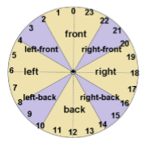
Qualitative Approach to Represent Direction and Distance
This work uses EOPRAm calculus to represent the relation between any two objects as a tuple of orientation and distance.
A granularity parameter of m=6 and a viewpoint orientation of being in front of the agent have been considered
Totally that gives us 24 direction sectors. These direction sectors are grouped into 8 regions: left, right, front, back, left-front, right-front, left-back and right-back.
We considered the left, front, right and back
regions as being more important orientation regions
than others, so they have an angular region of 60.
Notes:
[8]. Dorr, C.H., Latecki, L.J., Moratz, R.: Shape similarity based on the qualitative spatial reasoning calculus eOPRAm. In: Fabrikant, S.I., Raubal, M., Bertolotto, M., Davies, C., Freundschuh, S., Bell, S. (eds.) COSIT 2015. LNCS, vol. 9368, pp. 130–150. Springer, Heidelberg (2015). doi:10.1007/978-3-319-23374-1 7.
[9]. Moratz, R., Wallgr¨un, J.O.: Spatial reasoning with augmented points: extending cardinal directions with local distances. J. Spat. Inf. Sci. 5(5), 1–30 (2012)

Slide 11
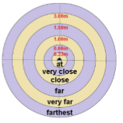
Regarding the elevated point and distance relations, a granularity parameter of n = 6 was assumed, creating 12 distance sectors.
These distance sectors are then grouped into 6 categories: at, very close, close, far, very far and farthest.
Based on [9] and in the agent’s height (0.55m), the regions were deﬁned as:
at – object < 0.33m,
very close - object between 0.33 and 0.66m,
close – object between 0.66 and 1.00m,
far – object between 1.00 and 1.50m,
very far – object between 1.50 and 3.00m, and
farthest – object > 3.00m.
Notes:
[9]. Moratz, R., Wallgr¨un, J.O.: Spatial reasoning with augmented points: extending cardinal directions with local distances. J. Spat. Inf. Sci. 5(5), 1–30 (2012)

Slide 12
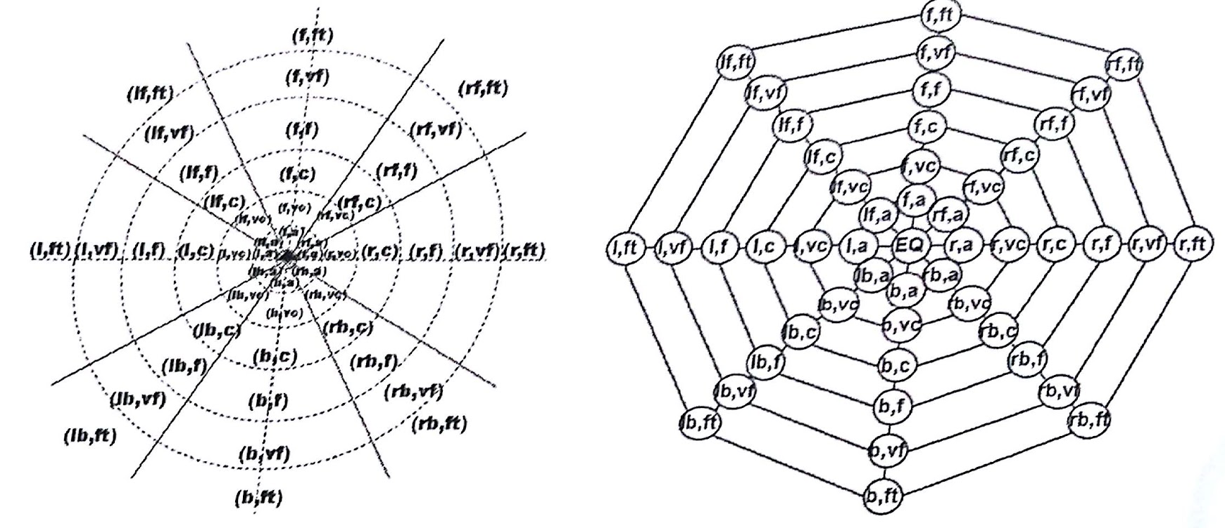
Qualitative Discretization of Direction and Distance
This Figure represents the CND of EOPRA6.
The nodes describe all qualitative relations and the edges describe its transformation to another relation
This figure represents the qualitative discretization created, in which the orientation and distance has a granularity parameter of m=6.
It is named EOPRA6
At the center, a region named equal corresponds to the agent’s positon and the position of any object to the agent.
Notes:
Figure2a presents the qualitative discretization created, in which the orientation and distance has granularity parameter m = 6, named EOPRA6.
At the center of EOPRA6, a region labeled equal corresponds to the agent’s position and the position of any object to the agent.
Figure2b presents the CND of EOPRA6. The nodes describe all qualitative relations and the edges describe its transformation to another relation.

Slide 13
Dminφ(X1,X2) or the Distance Function maps 2 relations to the minimum CND distance between them.
This distance can be computed using any algorithm to ﬁnd the shortest path between nodes in a graph, such as Dijkstra’s algorithm
Using this distance function, a Distance Matrix for CND can be created with the minimal CND node-node path distance between the 49 relations, allowing a quick retrieval during distance calculation*
[*] The distance matrix for EOPRA6 is available at the URL https://goo.gl/photos/ nJ83KngMH6i789xz7.

Slide 14
Qualitative Case Representation
Inspired by the work of [10], We now represent a qualitative case (C) as:
The problem description (P) and
The solution description (A):
C =(P,A)
P is given by the qualitative direction and distance to each object, from the agent viewpoint:
P ={ R₁ :[O₁,O₂,...O_{u}], … ,R_{v} :[O₁,O₂,...O_{u}] }
Where , v is the number of agents in the problem,
u is the number of objects that each agent can perceive,
R_{i} is the number of the agent and
O₁,O₂,...,O_{u} are the qualitative relations between the object and the current agent
Notes:
[10]. Ros, R., Arcos, J.L., de Mantaras, R.L., Veloso, M.: A case-based approach for coordinated action selection in robot soccer. Artif. Intell. 173(9–10), 1014–1039 (2009

Slide 15
Contd.
A - describes a sequence of actions each agent must perform to solve the problem, as shown in below expression:
A ={ R₁ :[ a₁₁,a₁₂, … ,a_{1p1}], ... ,Rv :[ a_{v1},a_{v2}, … ,a_{vpv}] }
It must be noted that he use of the case scope (K) is not necessarily just to the qualitative representation of cases,
Therefore, the qualitative spatial position of objects in the environment is a region and not a point on the coordinate plane.
Notes:
[10]. Ros, R., Arcos, J.L., de Mantaras, R.L., Veloso, M.: A case-based approach for coordinated action selection in robot soccer. Artif. Intell. 173(9–10), 1014–1039 (2009

Slide 16
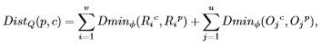
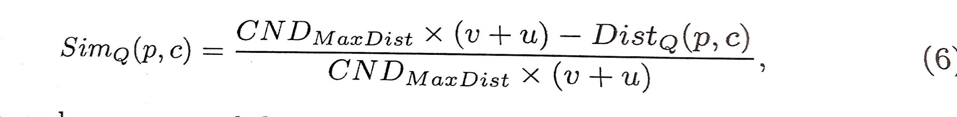
Qualitative Case Retrieval
In general, the retrieval step consists of measuring the similarities between the new problem and the solved problems stored in the case base.The present work uses the distance between objects in the CND to compute the similarity between the new problem and the cases in the case base.
This can be done using the distance function, used to compute the distance matrix
The qualitative distance function is deﬁned as:
where
v is the number of robots that take part in the case solution,
u is the number of objects that each agent can perceive,
R_{i}^{c} the qualitative position of each robot iin the case and R_{i}^{p} its qualitative position in the problem,
O_{j}^{c} the qualitative position of each object j in the case and O_{j}^{p} its qualitative position in the problem.

Slide 17
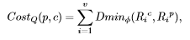
Retrieval : Adaption
The qualitative adaptation cost function is deﬁned as:
where v is the number of robots that take part in the case solution and
R_{i}^{c} the qualitative position of each robot i in the case and R_{i}^{p} its qualitative position in the problem.
The adaptation cost function includes only robots that are of the same team as the agent, meaning that their position can be controlled (i.e., adapted).
The adaptation cost is the cost to move the robots of the team to the position that is described in the most similar candidate case.

Slide 18
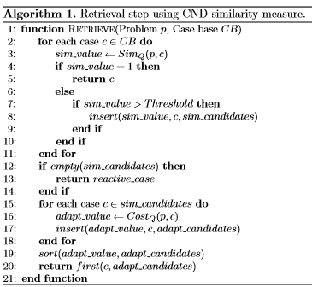
Retrieval : Algorithm
Algorithm1 presents the proposed retrieval method based on CND distance measure and adaptation cost.
This consists of a naive behavior,
in which the robot searches for the ball
and walks toward it, aligns itself with
respect to the opposing goal and kicks
forward.
Notes:
In this algorithm, there are two lists:
sim candidates which contains cases that are above a minimum similarity value (threshold); and
the list adapt candidates .
that is used to compute the adaptation cost of the candidate cases, ordered by their cost.
Lines 2–11 search for candidate cases in the entire case base.
Line 3 measures the qualitative similarity from problem to case using Eq.6.
In lines 4–5, if a case that is equal to the problem is found, the function returns it and ends the search. If no case is found within the similarity range allowed, a pre-deﬁned, reactive case is returned (lines 12–13).
Lines 15–20 compute the cost of adaptation of each case that was found in the previous steps, sort them by the adaptation cost, and return the one with the lowest adaptation cost (sim value is the second sort criteria).
The reactive behavior returns when no similar case is retrieved (lines 12–13)

Slide 19
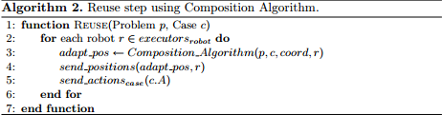
Qualitative Case Reuse
This step is for adapting the position of robot in the problem space with respect to the qualitative position of the retrieved case
Reuse Algorithm utilizes the Composition Algorithm to calculate the distance between Rexe ( an executor robot that is a part of solution space) and Rret (virtual robot that represents executor robot position in retrieved cases)

Slide 20
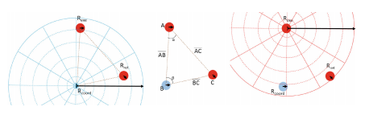
Composition Algorithm
444444
This image shows the R_{coord} point of view about R_{exe} qualitative position and the robots position on retrieved case . R_{coord} obtains the angle 𝝱 so that angle α using cosine law. The Qualitative distance is calculated by pythagorean theorem.

Slide 21
Experiment And Results
Two major Experiments were used for Testing
Simulator based Experiments
Experiments with Real Robots
The approach which results in more goals being scored, while minimizing overall amount of errors and time required to retrieve similar cases will be deemed more efficient.

Slide 22
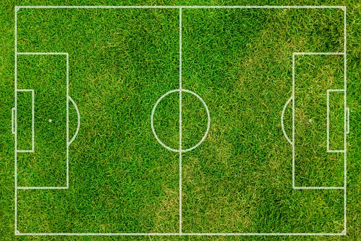
Simulation Experiment
This experiment was carried out using RoboFEI Humanoid soccer simulator which implements low level process such as vision, control and communication process.
Two scenarios were created:

Slide 23
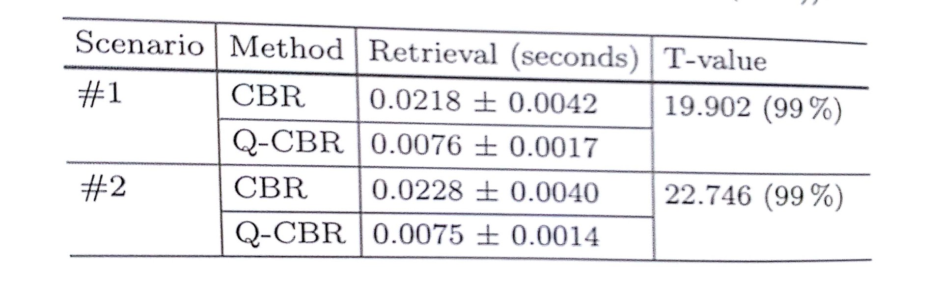
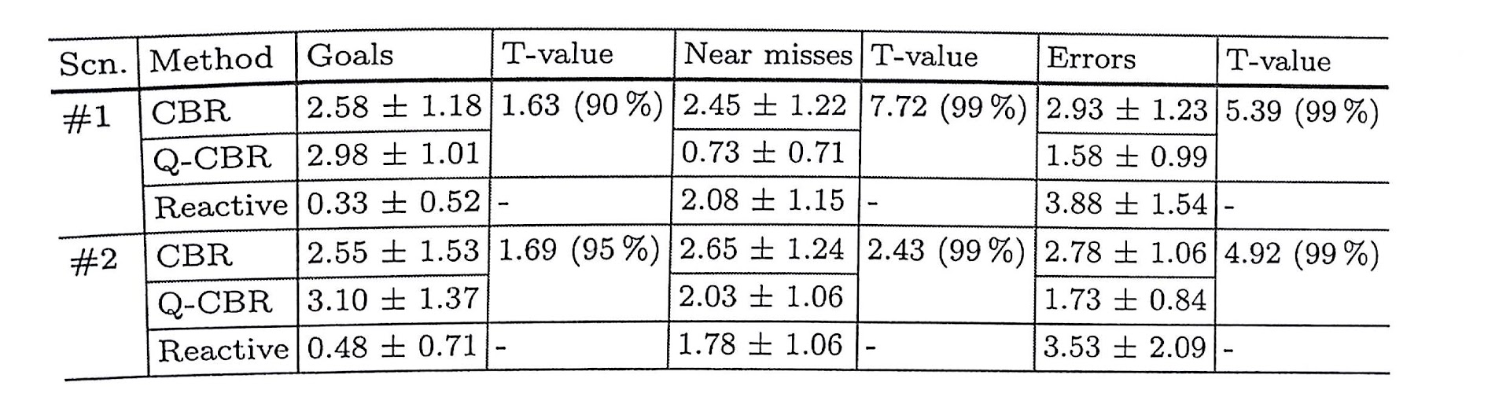
Case base for Two scenarios
Quantitative case base was built with 20 real cases and 180 random cases with random positions and three actions for each robot
Qualitative case base with the same 200 cases were represented as qualitative relations
These 20 cases were hard coded and represented the specific positions of the robots, along with the actions it must perform to solve a problem.
In the reactive approach the robot walks towards the ball, aligns and kicks it with a very uncoordinated action. 40 trials of 10min were performed for each scenario.
Results of the Performance of CBR and Q-CBR Retrieval Steps
Q-CBR obtained slightly higher average number of goals and was 3 times faster on similar case retrieval.

Slide 24
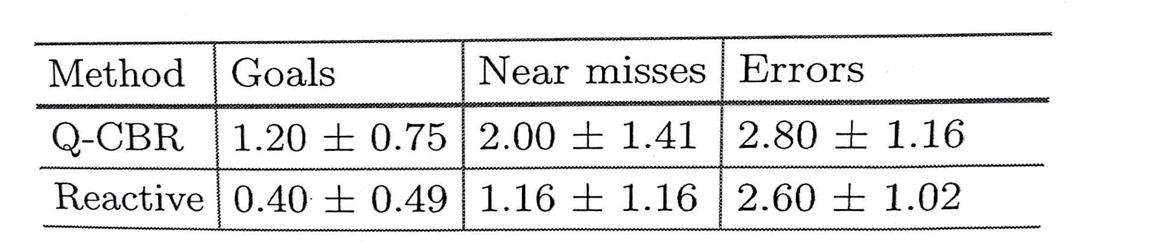
Experiment with Real Robots
In this domain, the robots cannot figure out global positions of the agents as it uses the camera as a primary input device. Thus the qualitative spatial representation becomes an easy way to model, retrieve and reuse the cases.
The scenario is similar to scenario 2 in simulated experiment with same case base Only the vision and control modules of the cross architecture is changed.
Thus the robot is able to recognize the ball and other robots, communicate with each other and perform basic tasks like walking, turning, kicking and passing.
This experiment consist of 5 trials of 10 min, and as in previous experiments, the average number of goals, number of near misses and the number of errors were considered. The metric based CBR is not used since the coordinates of ball in the field is not given
In this experiment, the Q-CBR is statistically better for scored goals than the reactive approach with a certainty of at least 95%

Slide 25
Conclusion
Case Retrieval and performance was boosted using the CBR system coupled with the CND similarity measure.
In some domains, the use of qualitative representation is more appropriate than quantitative values. The humanoid robot soccer is an example of that.
We hence see that the proposed method increased the number of scored goals and decreases the average time spent to retrieve a case.

Slide 26
Thank you.

